Slide 1
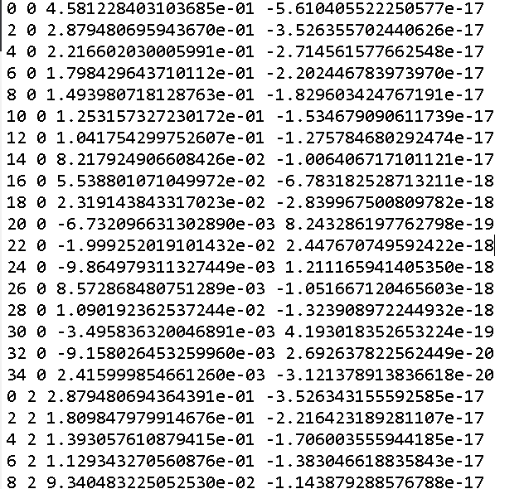
Mengyuan Tophat Mode Coefficients
n m Real Imag

Slide 2
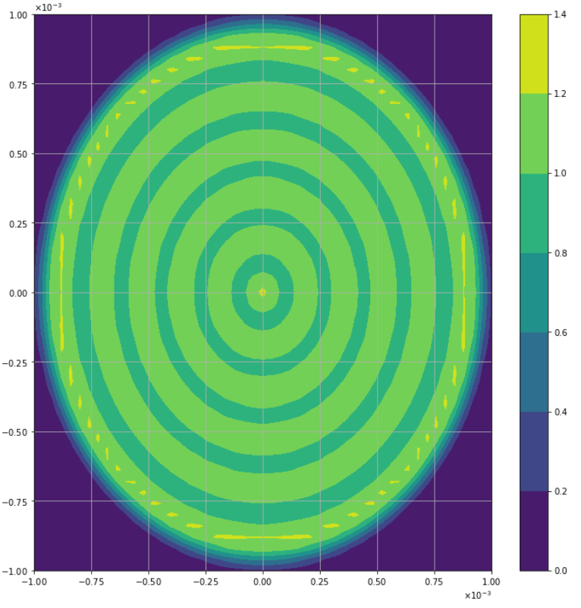
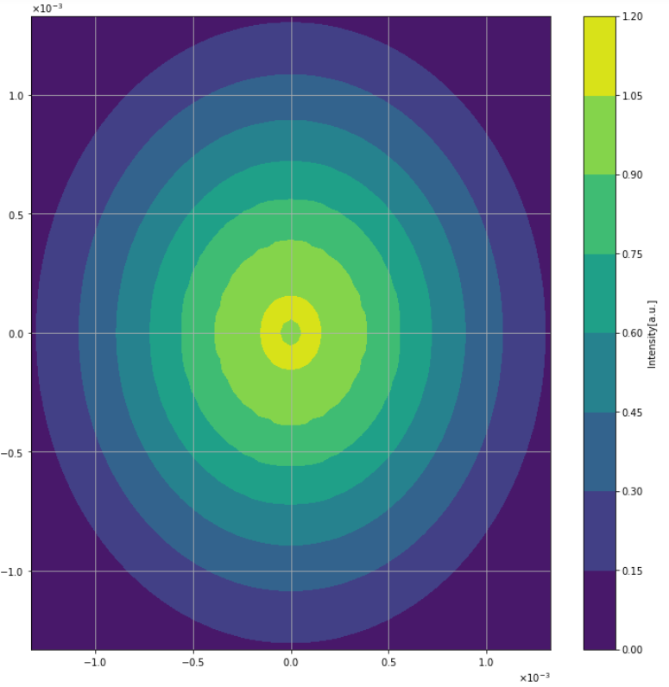
“Unit” Tophats
Alex/Paul Coeff.
Mengyuan Coeff.

Slide 3
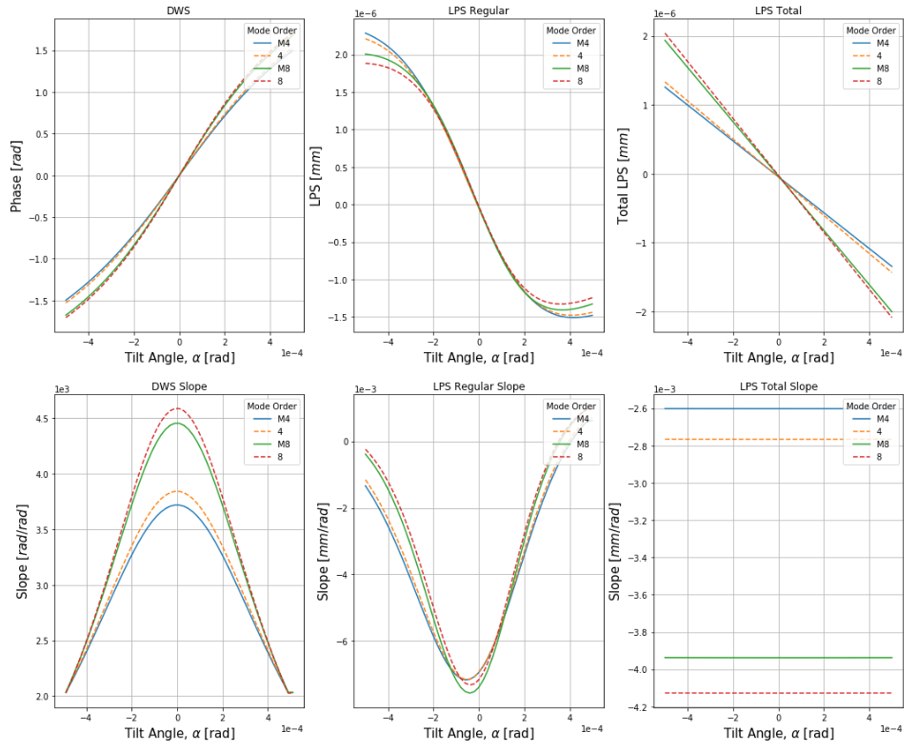
Truncated Tophat Mode Orders(4 & 8)

